Slide 1
System Identification
Using Delta rule learning

Slide 2
Delta Rule Learning
Among neural network models, the Delta rule learning is Supervised learning algorithm.
Developed by Widrow and Hoff, the delta rule, also called the Least Mean Square (LMS) method, is one of the most commonly used learning rules
For a given input vector, the output vector is compared to the correct answer. If the difference is zero, no learning takes place; otherwise, the weights are adjusted to reduce this difference.

Slide 3
System Identification using Delta Rule
The Delta rule /LMS Algorithm consists of two basic processes
Filtering process
Calculate the output of FIR filter by convolving input and taps
Calculate estimation error by comparing the output to desired signal
Adaptation process
Adjust tap weights based on the estimation error

Slide 4
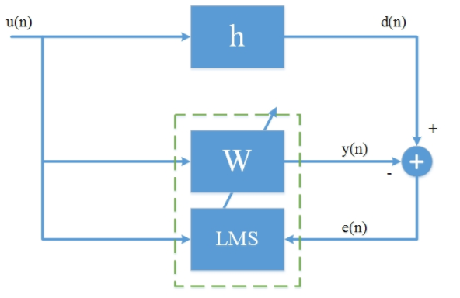
Block Diagram

Slide 5
Block Diagram
What is u(n)?

Slide 6
Block Diagram
What is u(n)?
u(n) is the random input sample

Slide 7
Block Diagram

Slide 8
Block Diagram
What is u(n)?
u(n) is the random input sample
What is h?

Slide 9
Block Diagram
What is u(n)?
u(n) is the random input sample
What is h?
h is the original FIR filter with system coefficients or properties

Slide 10
Block Diagram

Slide 11
Block Diagram
What is u(n)?
u(n) is the random input sample
What is h?
h is the original FIR filter with system coefficients or properties
What is d(n)?

Slide 12
Block Diagram
What is u(n)?
u(n) is the random input sample
What is h?
h is the original FIR filter with system coefficients or properties
What is d(n)?
d(n) is the desired output signal and is obtained by convolving input data with FIR filter coefficients.

Slide 13
Block Diagram

Slide 14
Block Diagram
What is u(n)?
u(n) is the random input sample
What is h?
h is the original FIR filter with system coefficients or properties
What is d(n)?
d(n) is the desired output signal and is obtained by convolving input data with FIR filter coefficients.
What is W?

Slide 15
Block Diagram
What is u(n)?
u(n) is the random input sample
What is h?
h is the original FIR filter with system coefficients or properties
What is d(n)?
d(n) is the desired output signal and is obtained by convolving input data with FIR filter coefficients.
What is W?
W(n) is the Adaptive FIR filter coefficients which are initially zero and obtained by training the system using u(n) and d(n).

Slide 16
Code review

Slide 17
References
Delta Rule : https://en.wikipedia.org/wiki/Delta_rule
The Adaptive Filters, Simon Haykin -https://books.google.de/books/about/Adaptive_filter_theory.html?id=E5hTAAAAMAAJ&redir_esc=y
Neural networks Delta rule : http://uhavax.hartford.edu/compsci/neural-networks-delta-rule.html
Adaptive Filters , Bernard Widrow : http://www-isl.stanford.edu/~widrow/papers/b1971adaptivefilters.pdf
System Identification: https://en.wikipedia.org/wiki/System_identification
Black Box : https://en.wikipedia.org/wiki/Black_box

Slide 18
Any Questions ?

Slide 19
Thank You

